Slide 1

Building an Image Segmentation Model for a CV System
Presented by: Octave Antoni
Last Updated: November 5th, 2022

Slide 2
Table of contents
Introduction
Image data Processing
Image Segmention
Deploying the model
Conclusion

Slide 3
Introduction
Main goal ➔ Create an Image Segmentation Model that will be used in a Computer Vision System used by a Self-Driving Vehicle.
Use of the Cityscrapes dataset
Segmentation of images by Category
Key points :
Implementation of the model in the Keras framework
Deployment of an API and of a visualization application on Flask/Heroku
Redaction of a technical note to delve deeper into technical details
Limitation : Azure Credits not provided to student ➔ Only low performance computes could be used (trial account) ➔ Low number of training epochs and high training time

Slide 4
Image Data Processing

Slide 5
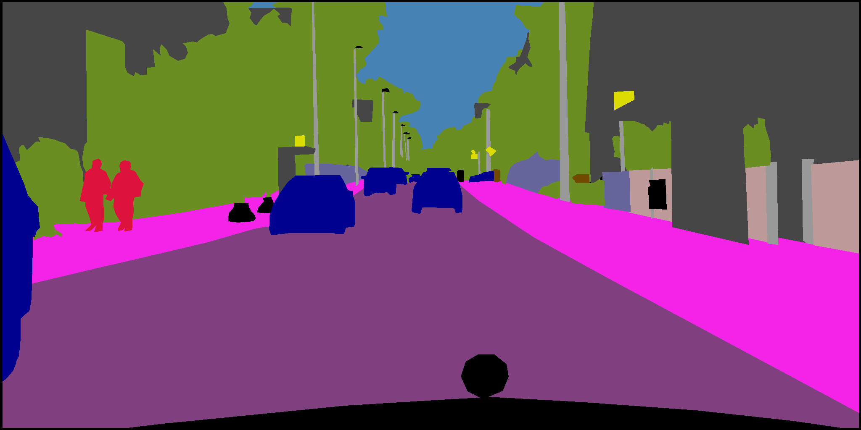
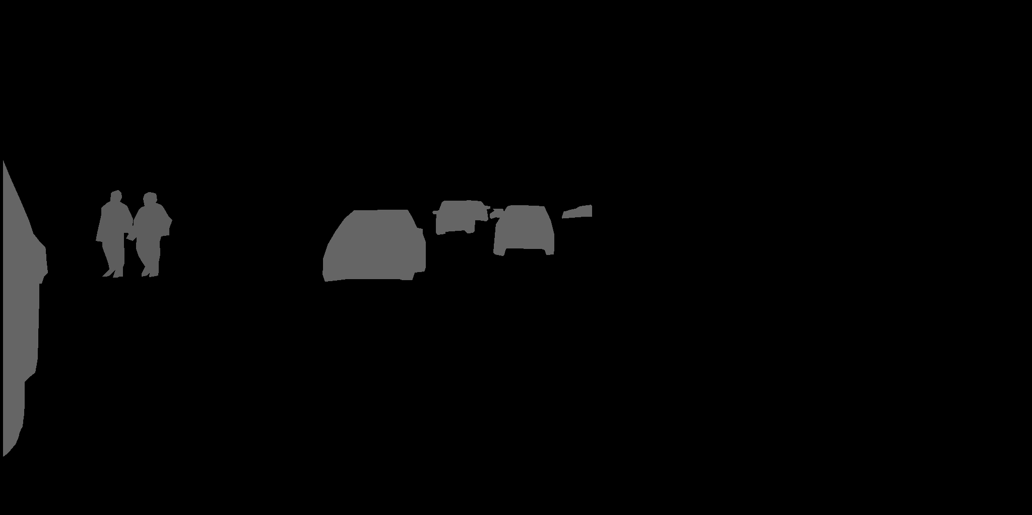
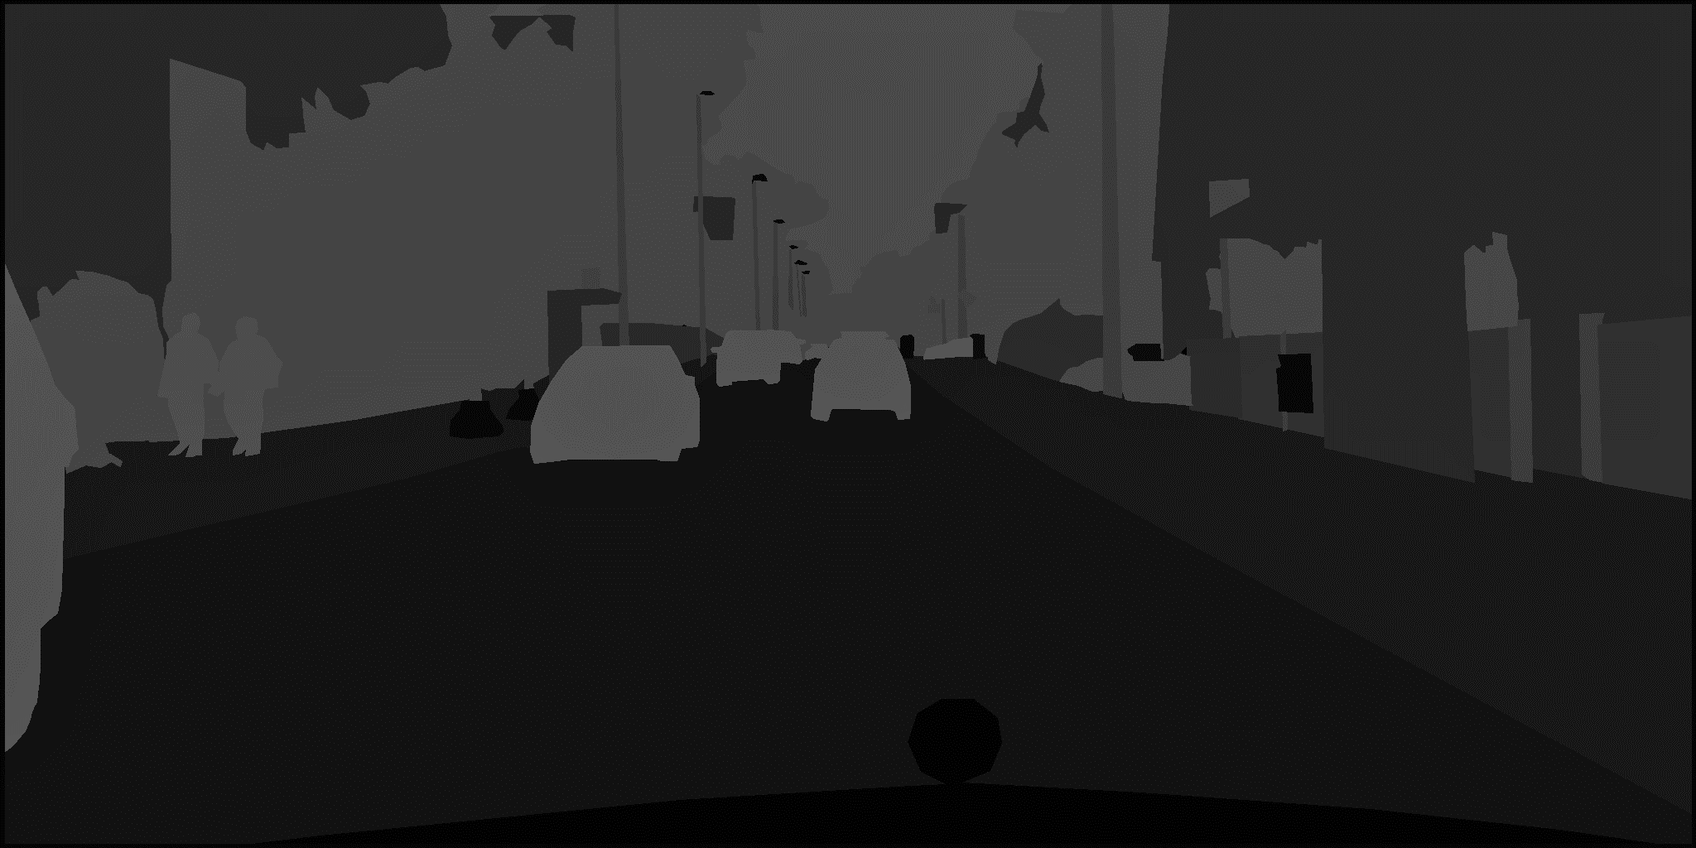
Dataset
Cityscrapes dataset:
5000 labelled photos
Fixed 1024*2048 size
Downloading from the source requires .edu email adress
Invalid test masks ➔ 3475 valid photos
4 types of mask data:
Colored masks using custom RGB scale
Masks labelled with instance ID of certain type of objects
Semantic Labelled masks ➔ Used for the project
Json file with segment and instance coordinates
Colored
Mask
Instance Id
Labelled
Mask
Class Id
Labelled
Mask

Slide 6
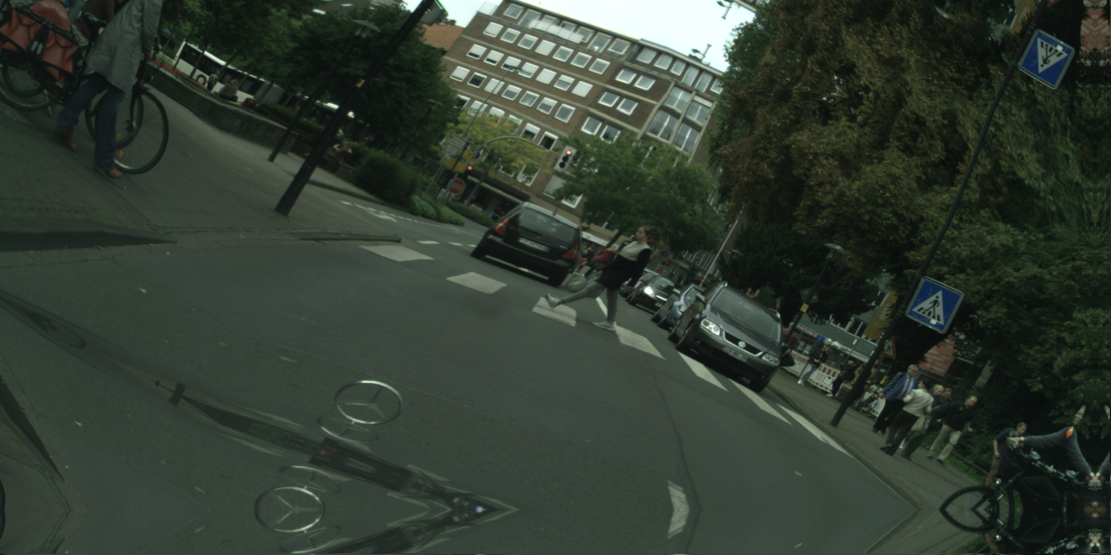
Image Data Preprocessing
Base Image
Copy
Copy
Reduction of shape to 256x256 ➔ 256x512 (preservation of aspect ratio)
Image Normalization with encoder preprocessing function
One-hot encoding mask labels (converting 1024x2048 masks to 1024x2048x3 arrays)
Testing of different data augmentation techniques:
No data augmentation applied
Data augmentation within pipeline
Using Albumentations to create additional augmented samples
➔ 3 times the number of initial samples
Horizontally Flipped Image
Base Image
Rotation (max 30°, p=0.5)
Random Brightness OR Contrast (p=0.7)
Elastic Transform OR Grid Distortion (p=0.5)
Flipped Augmented Image
Unflipped Augmented Image
Base Image

Slide 7
Deep Learning Image Segmentation

Slide 8
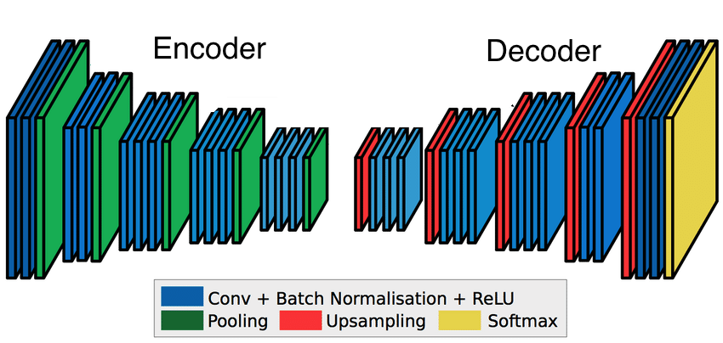
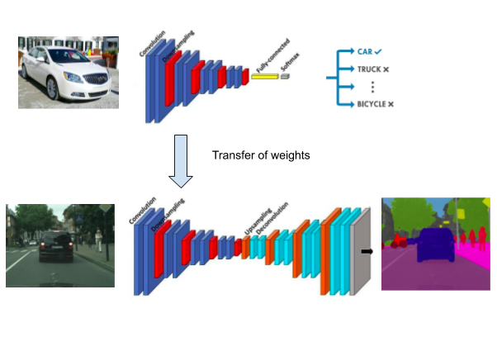
Image Segmentation principles
Semantic Image Segmentation
Use of Convolutional Neural Networks (CNN)
Performance Metrics : Dice Coefficient – Intersection over Union (IoU) – Mean One-Hot
Other metric : shape of the predicted masks
Optimizer : Adam – Adam Weighted (AdamW)
Loss : Cross-Entropy – Dice Loss
Use of skip connections to prevent the loss of low-level information
Transfer learning for encoder necessary ➔ reduce computation time

Slide 9
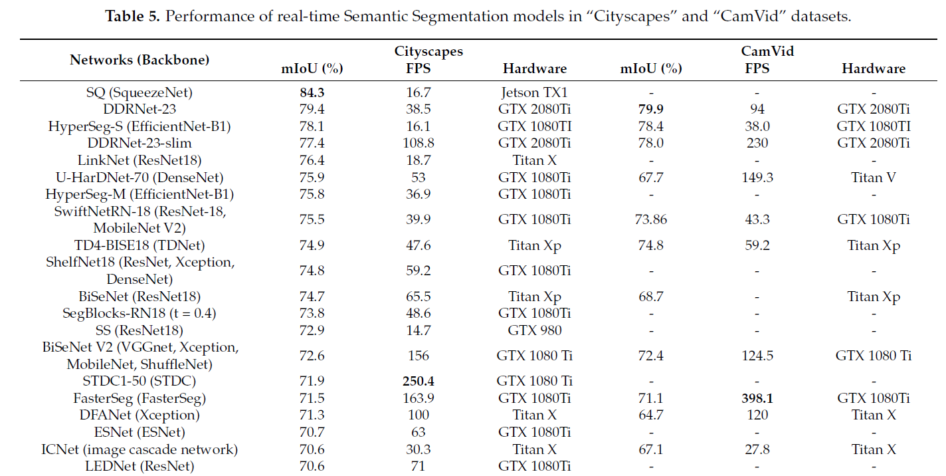
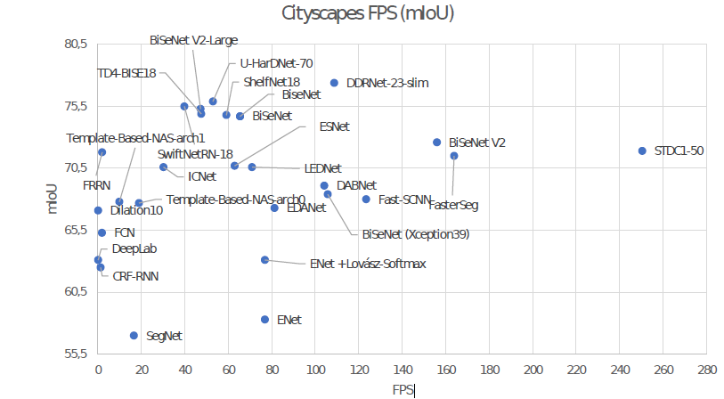
State of the Art Semantic Segmentation
Study of research paper : Real-Time Semantic Image Segmentation with Deep Learning for Autonomous Driving : A Survey
Best performance on Cityscrapes dataset : SQ (SqueezeNet encoder)
Fastest model : STDC1-50 (STDC backbone)
2 main problems with state of the art models:
Models not implemented in Keras / TF
Training requires high computational power
SQ
Performance reached by final model
73.5

Slide 10
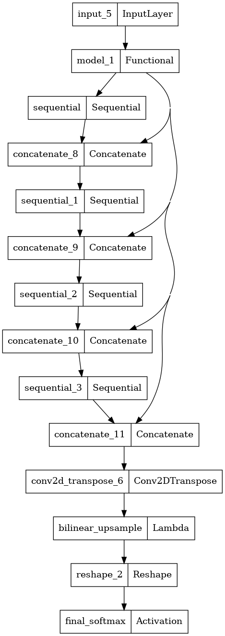
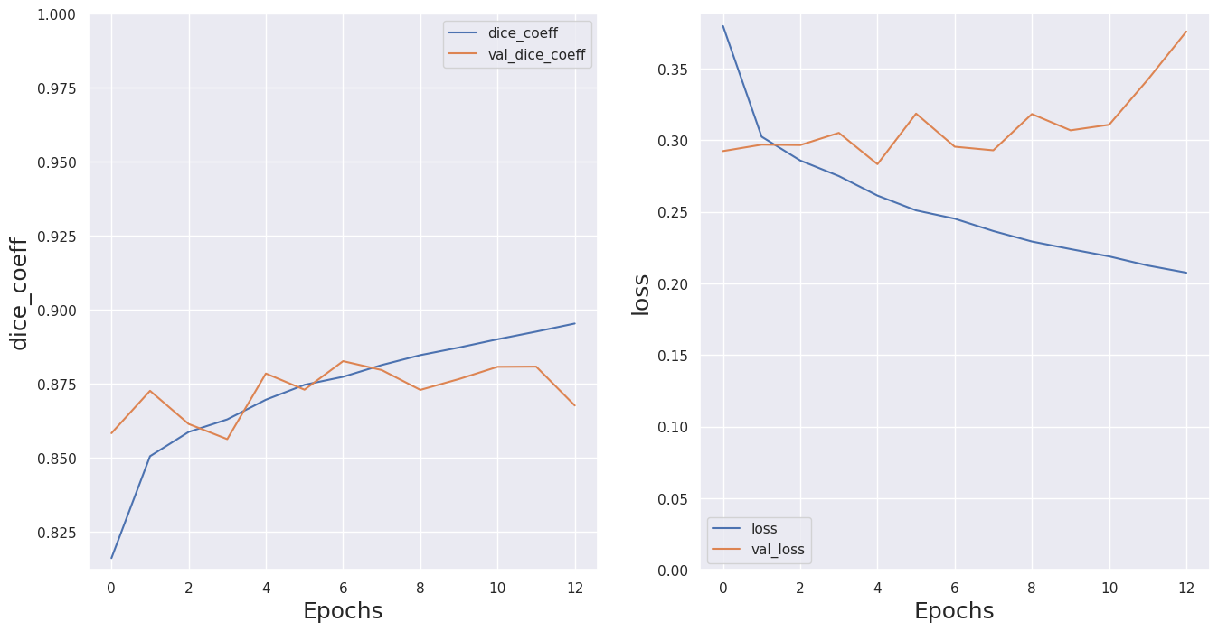
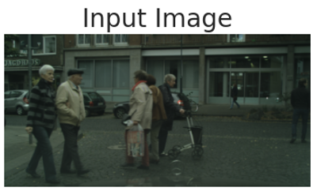
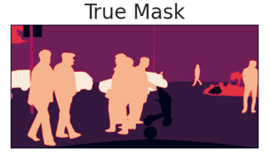
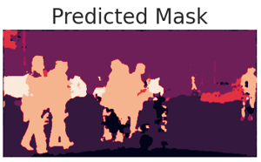
MobileNet - UNet
Encoder used : MobileNetV2 loaded with ImageNet weights
Decoder : Modified version of UNet
Use of skip connections between 4 MobileNetV2 layers and UNet upsamplers
Different versions tested:
256x256 and 256x512 image size
With or without data augmentation
JaccardLoss / Categ. CrossEntropy
Final Dice Coeff: 0.885 Mean IOU : 0.573
Accuracy : 0.911

Slide 11
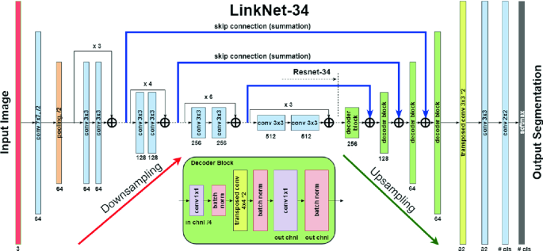
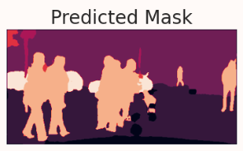
ResNet18 - LinkNet
Encoder used : ResNet18 loaded with ImageNet weights
Decoder : base version of LinkNet
Automatic generation of model architecture with segmentation-models module
Final Dice Coeff: 0.909 Mean IOU : 0.732
Accuracy : 0.927
Best performance on all metrics : Comparable to state of the art models, with only 70% of training samples

Slide 12
Cloud based Model Deployment

Slide 13
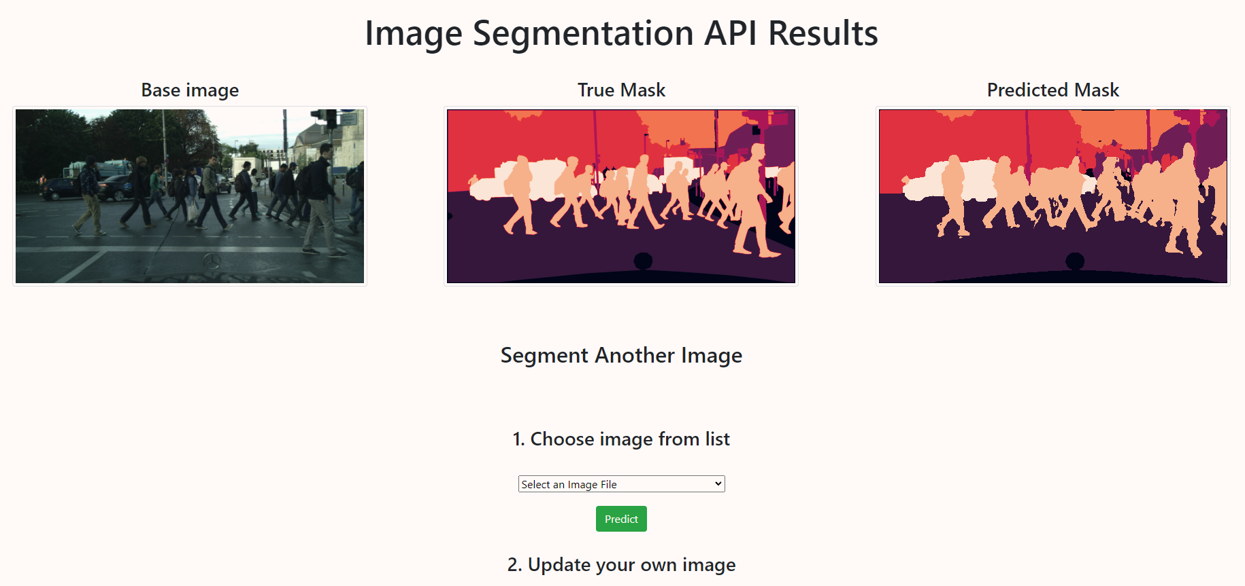
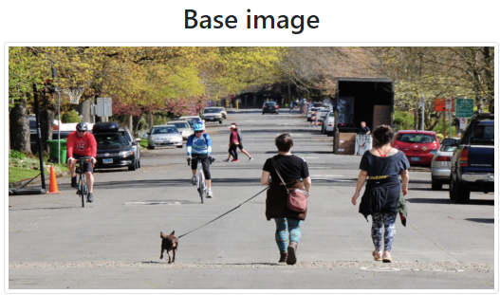
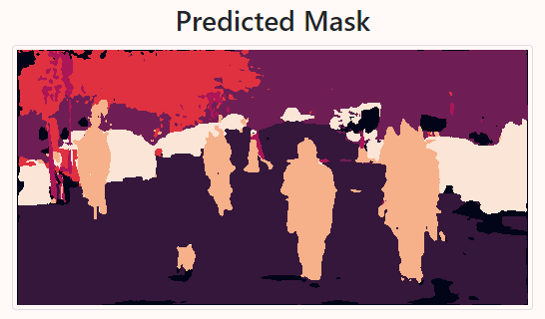
Model Deployment on the cloud
Implementation on Flask
Deployment on Heroku (premium dyno)
Limited by the size of the deployment, necessity to host model weights on Amazon S3
Model has to be recompiled at application launch to reduce host size
Tested on “real” pictures
2 possibilities :
Predict one of the uploaded test image
Predict a user-uploaded image

Slide 14
Conclusion

Slide 15
Conclusion
During this project, an Semantic Image Segmentation model has been developed based on images extracted from the Cityscrapes dataset.
The model developed so far can be refined before deployment in production
Recommendations :
Use developed ResNet18 – LinkNet model as base for further work
Use high performance computes ➔ increase the number of training epochs.
Increase image size used in training to native resolution (1024x2048)
Verify FPS of model to assert compatibility with Computer Vision System
Perform fine-tuning of ResNet18 encoder by unfreezing top layers

Slide 16
Questions?

